Slide 1


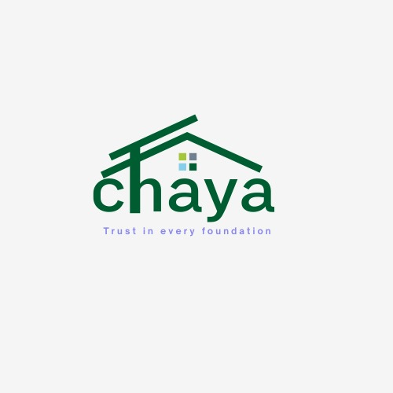

CHAYA
Trust in Every Foundation
1

Slide 2
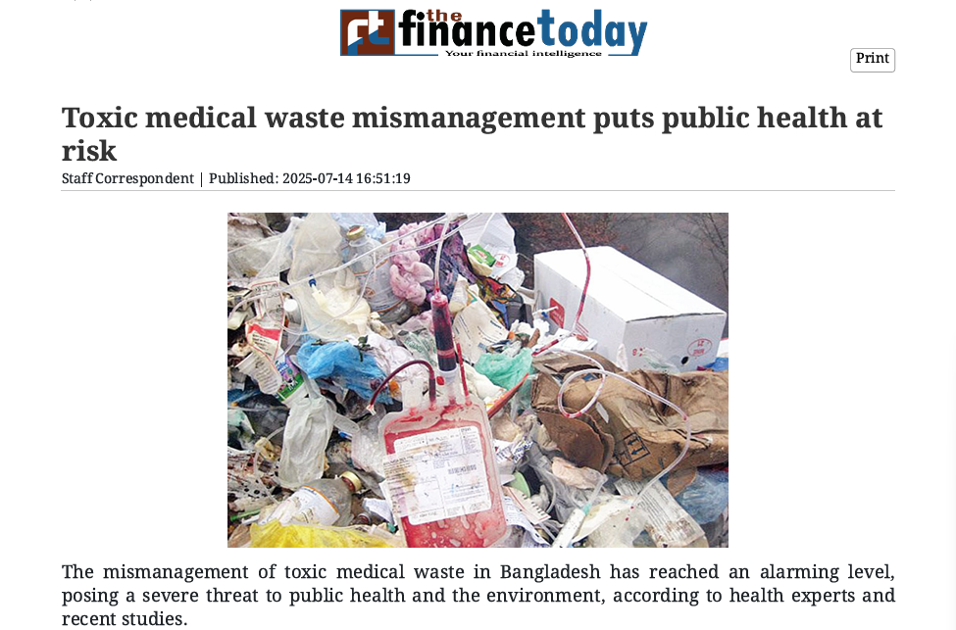
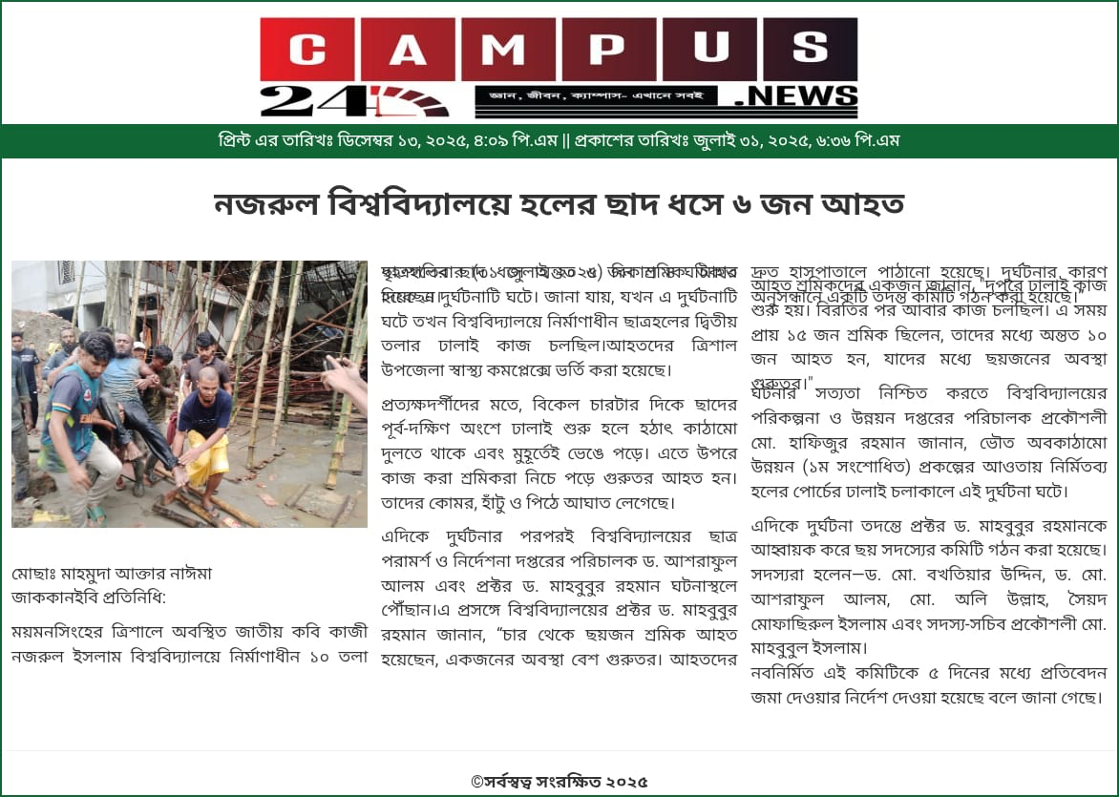
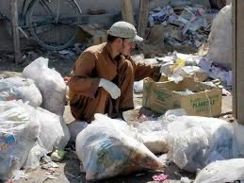
LISTEN!!
Unsafe disposal of medical waste is silently putting public health and the environment at serious risk.
people were injured after the roof of an under-construction hall
2

Slide 3
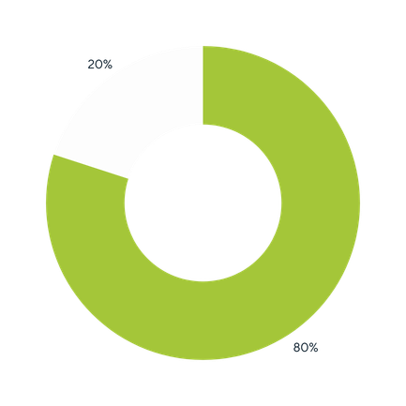
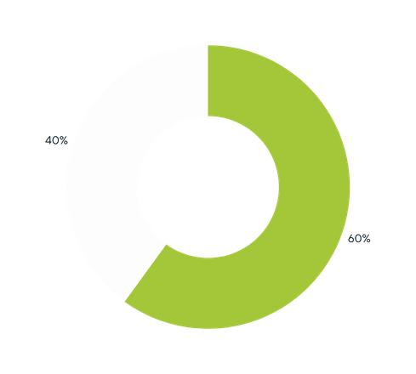
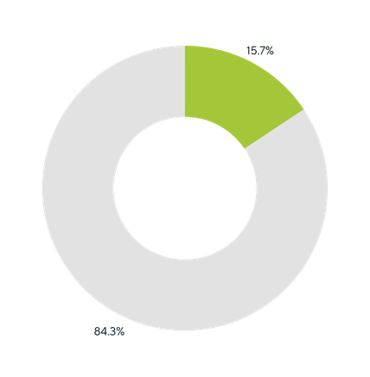
PROBLEM
80%
60%
15.7%
Lack of low cost
infrastructure
Traditional materials aren’t adaptable for multi-use
Environmental waste
BBS-2021
BRAC UDP-2021
UNICEF Hygiene Management-2020
3

Slide 4
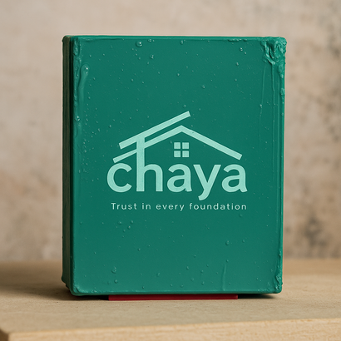
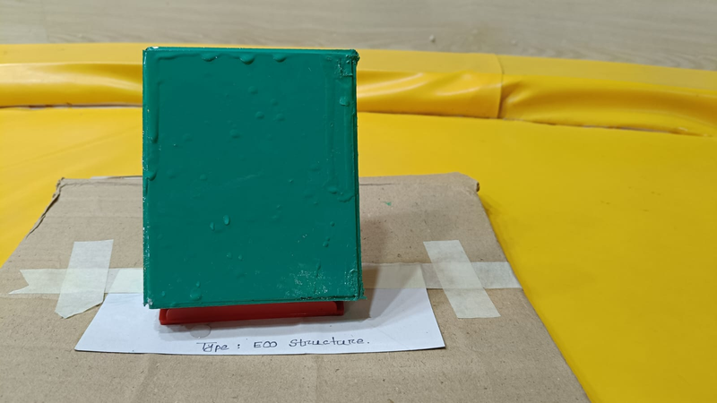
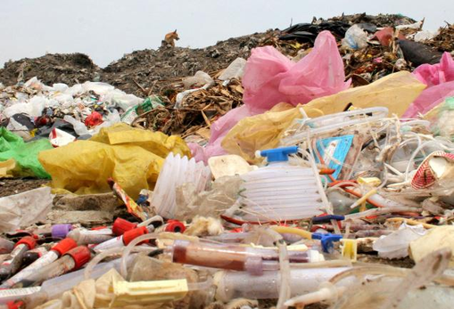

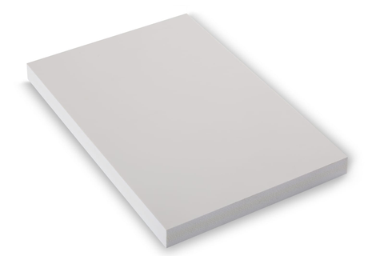

SOLUTION
“Converting Waste into Sustainable Structure : An Eco-friendly Structure”
Scalable
Low cost
Sustainable
Eco Structure
Rust free
Waste
Color Coated
Non-Color Coated
MRP : 1200 BDT
MRP : 1000 BDT
4
Waterproof, easy-to-install and multi-purpose use shelter, built from waste, trusted for strength and impact

Slide 5
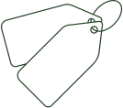



Trust In Every Foundation
Brand Positioning
Sustainable
Affordable
Strength
প্রয়োজনে স্থায়িত্ব, সমাধানে আমরা
Chaya provides strong, sustainable shelter that built from waste, designed for resilience, and made to uplift communities
Chaya
For the people
5

Slide 6
MARKET SIZE
Developing countries
Developing countries
TAM
Market value: 557.5B BDT
Whole Bd
SAM
Market value: 2.77B BDT
Sylhet,Narayangang,Rural upazila
SOM
Market value: 125.5MBDT
6

Slide 7
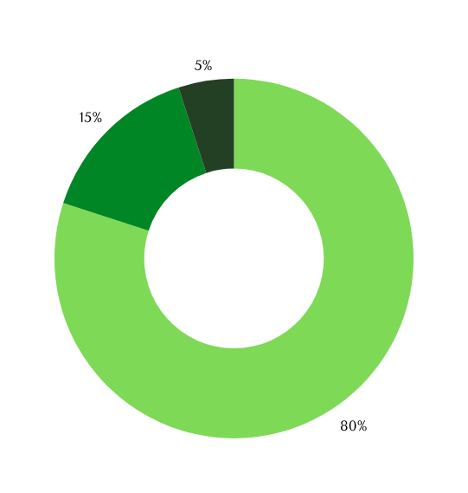






Consumer Analysis
When NGOs, small businesses, construction workers were asked whether they were willing to make the switch, they responded:
Socio Economic
Psychographics
Behavioural
Slum Dwellers: Low income, high vulnerability, need affordable shelter.
NGOs: Budget-constrained, need scalable, sustainable solutions.
Real Estate: Profit-driven, seeking cost-effective alternatives.
Rural Users: Word-of-mouth, visual proof builds trust.
NGOs: Data-driven, storydriven, pilot-based buying.
Govt: Tender-based, performance-focused, brandaware
End Users: Value safety, comfort and dignity.
NGOs: Driven by impact, environment, and equity.
Developers: Want innovation, speed, and green credibility.
Willing to use EcoRoof instead of tin roofing
Interested but hesitant , requesting empirical evidence
Undecided , mainly due to lack of prior exposure to recycled materials
7

Slide 8





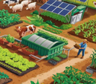
GO TO MARKET
Developer
Meetups
B2B Deals
Direct
Contracts
Construction
Expo
Site Demos
Tech Sheets
Distributors
Supplier Meets
Farmer Groups
Rural Dealers
Micro
distributors
Agri-Tech
Fairs
Tender Portals
NGO Forums
Green Tags
Relief
projects
8

Slide 9
MARKET STRATEGY
Field
Activities
What We Will Achieve By 2030
B2B & Trade Shows
Attend expos, showcase product
200+ leads/year, 100+ developer deals
NGO & Govt Projects
Proposals, tender bids
25 MOUs, 20+ project adoptions
Eco-Awarene
Social media, radio, community outreach
50K+ reach, high awareness in rural & urban areas
Industrial Collaboration
Pilot with real estate, agro & factories
25 pilots, 10+ zone installations/years
Rural Market Access
NGO tie-ups, demo setups at village markets
50+ regions, 10K+ low-income households impacted
9

Slide 10

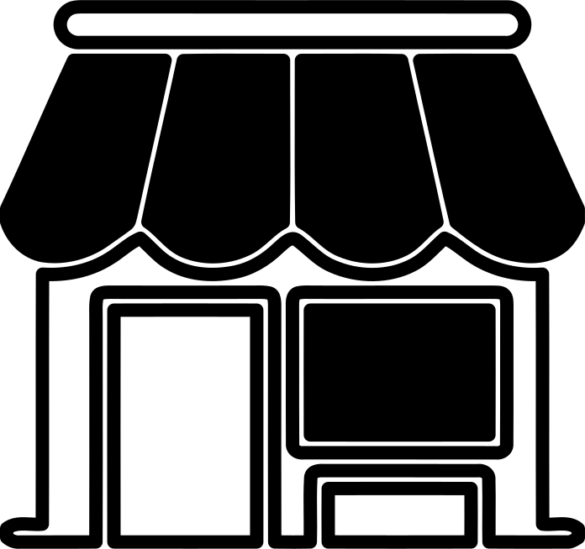


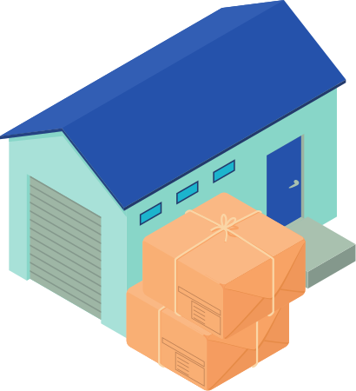

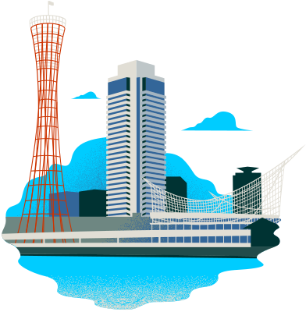
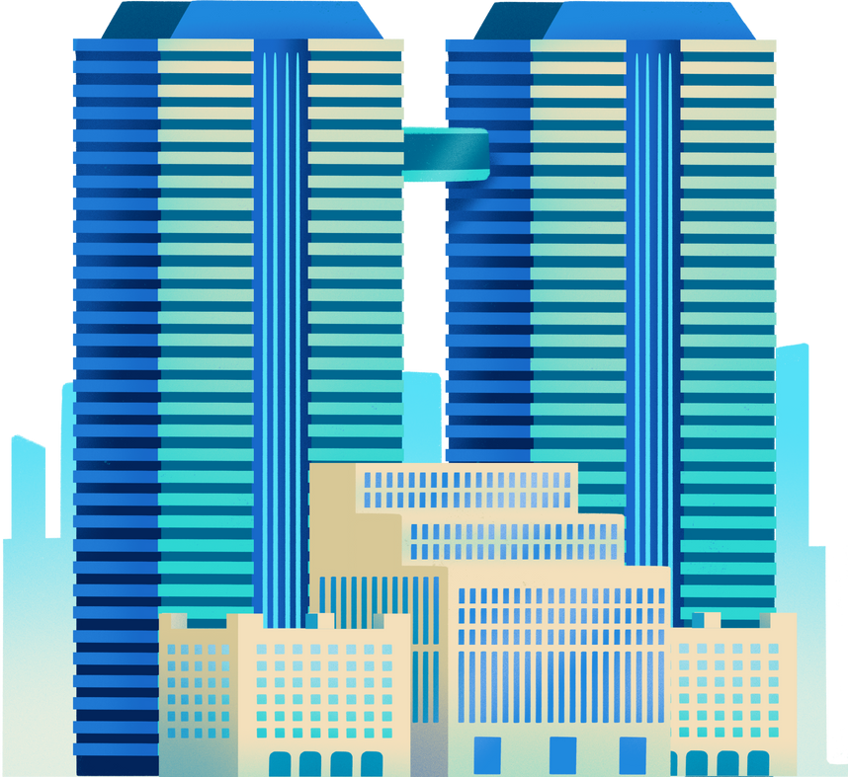
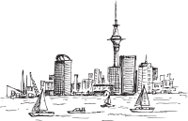


DISTRIBUTION PLAN
Zone-1
Zone-1
uttora,Mirpur,Dhanmondi
Agrabad,GEC,Chawkbazar
B2C
B2C
Zone-2
Dhaka central
Distribution Hub
Zone-2
Keraniganj,Jatrabari,Demra
Chittagong central
Distribution Hub
EPZ,Patenga,Halishahar
B2B
Zone-3
Zone-3
Savar,Tongi,Ashulia
Sitakunda,Patiya,Awara
Gabtoli industrial Area
Tejgoan Industrial Area
10
Key channels in B2C: Retail

Slide 11

COMPETITIVE ANALYSIS
Evaluation criteria | Chaya (Medical Waste Eco-roof) | Plastile | Traditional Tin | UPVC Sheet | Partex Plastic Sheet | Meghna Group Cement Sheet | Nazir Hossain Products
Material source | Sterilized medical-grade plastic waste | Reycled single-use plastic | Galvanized Iron/Steel | Virgin or Industrial recycled plastic | Virgin plastic | Cement + fibre | Mixed plastic waste + sand
Maintanance | Very low | Low | High (rust) | Low | Moderate | Moderate | Low-moderate
Load efficiency | Excellent-suitable for weak structures | Moderate | Excellent | Good | Good | Poor high-dead load | Moderate
Weight | Lightweight | Medium | Light | Light | Light | Very heavy | Light
Durability | High-moisture, chemical & rust-resistant | High | Moderate | High | Moderate | High but brittle | Moderate
Heat resistance & waterproofing | Excellent-low thermal conductivity , 100% waterproof | Good , waterproof | Very poor , waterproof initially | Good . waterproof | Moderate, waterproof | Poor-moderate , waterproof | Moderate, waterproof
11
11

Slide 12
FINANCIAL PROJECTION
YEAR | UNIT SOLD | REVENUE (BDT) | COGS (BDT) | NET PROFIT (BDT) | GROSS PROFIT (BDT) | TOTAL OPERATING EXPENSES (BDT)
Year 1 | 1333 | 1599600 | 1554775 | -925675 | 44825 | 970500
Year 2 | 2042 | 2450400 | 2123350 | -1007450 | 327050 | 1334500
Year 3 | 3125 | 3750000 | 3244375 | -1277375 | 505625 | 1783000
Year 4 | 9375 | 11250000 | 7578125 | 1425875 | 3671875 | 2246000
Year 5 | 16620 | 19944000 | 11762500 | 6797500 | 9419000 | 2621500
OUR BREAK-EVEN IS APPROXIMATELY AT 4 YEARS
12

Slide 13
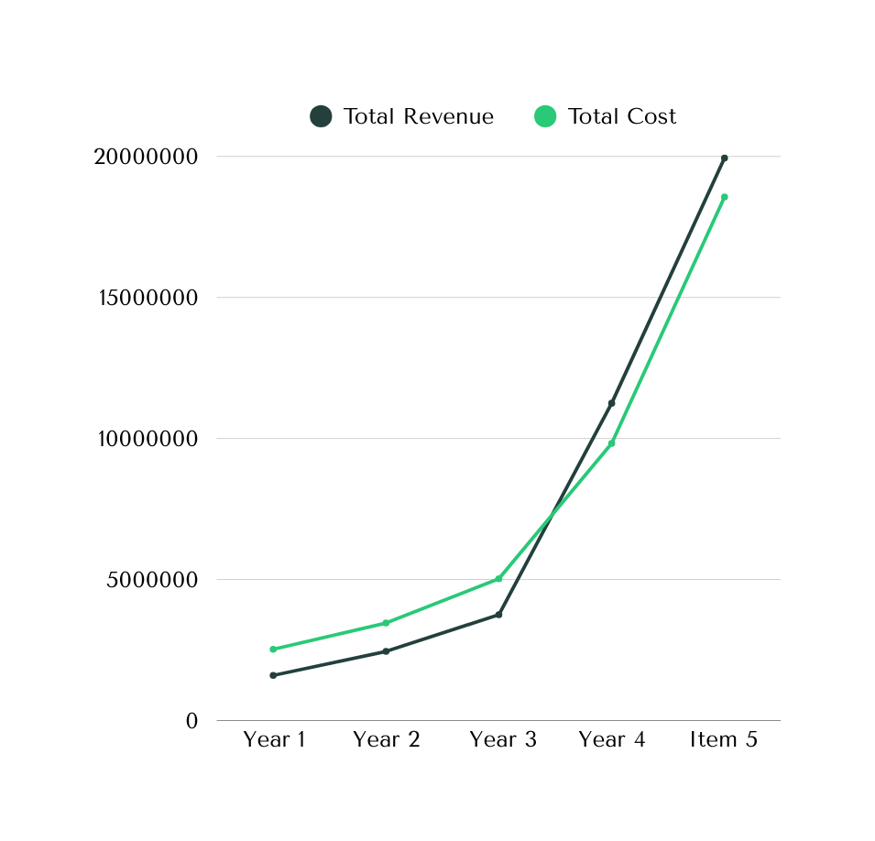
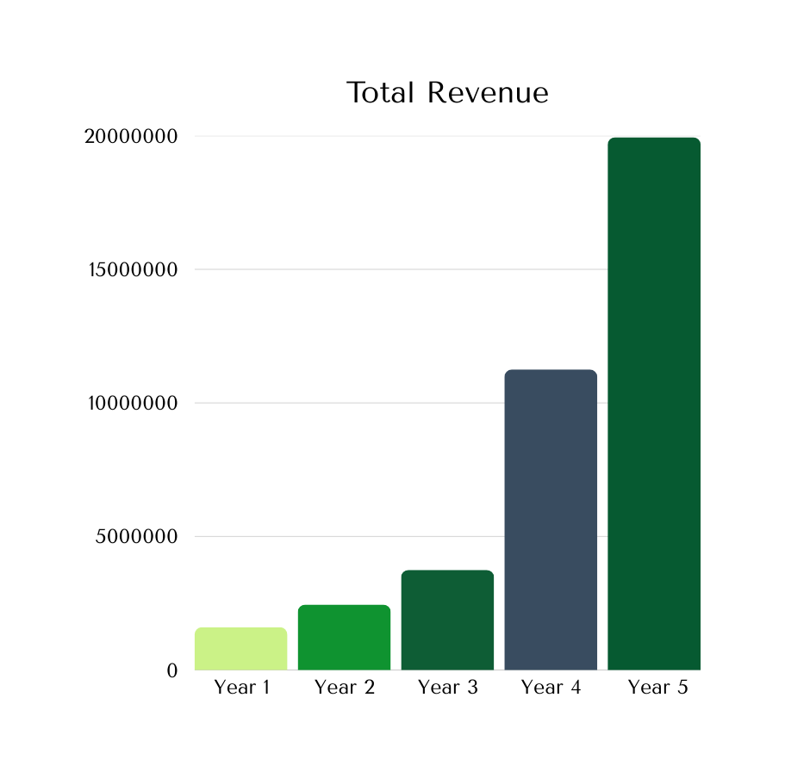


FINANCIAL PROJECTION
BREAK EVEN POINT
13

Slide 14












TIMELINE
2026-2027
Pilot launch, certification, local partners, brand setup
2030
2029
Market leadership, export/licensing, new products, smart infrastructure
National scale-up, public housing, supply chain, micro-distribution
2028
Regional production, early sales, training, grants
14

Slide 15









SDG Goals
SDG 9 – Industry, Innovation & Infrastructure
SDG 11 – Sustainable Cities & Communities
Transforming hazardous plastic waste into high-strength, rust-free infrastructure for a resilient future.
Providing low-cost, durable housing solutions that make urban and rural settlements safer and more inclusive.
SDG 12 – Responsible Consumption & Production
SDG 13 – Climate Action
Mitigating climate impact by diverting waste from landfills and providing heat-resistant, waterproof roofing that helps vulnerable communities
Closes the loop on non-biodegradable waste, converting environmental waste into a valuable building resource.
15

Slide 16
RISK AND MITIGATION
AGENDA
RISK |  | MITIGATION
Public health concerns over using sanitary waste. | MEDIUM | Ensure high-standard sterilization and certify safety through third-party lab tests.
Irregular supply of raw materials | HIGH | Partner with manufacturers and waste collectors
Market hesitation to adopt recycled roofing products. | MEDIUM | Offer demos and awareness campaigns to build trust and confidence.
16

Slide 17

APPENDICES

Slide 18
Financial Drafting
Category
Item
YEAR1
YEAR2
Year3
Revenue
Product Sales Service Revenue Other Revenue Direct Material Costs Direct Labor Costs Gross Profit Salaries & Wages Rent & Utilities Marketing & Advertising Software & Tools Professional Services Travel Maintenance Miscellaneous Depreciation Total Operating Expenses Operating Profit (EBIT) Other Income Interest Paid Net Profit Before Tax Tax (10%) Net Profit After Tax
900000
1350000
2250000
Cost of Goods Sold (COGS) Gross Profit Operating Expenses
240980 546000 113020 0 180000 75000 5000 169000 160000 100000 10000 5000 704000 -590980 1000000 130000 0 -720980
361350 624000 364650 0 180000 120000 6000 175000 240000 120000 12000 4000 857000 -492350
602250 780000 867750 260000 180000 50000 8000 128000 400000 130000 15000 2000 913000 -45250
Total Operating Expenses Operating Profit (EBIT) Other Income/Expenses Loan Interest Expense Net Profit Before Tax Tax (Assumed 10%) Net Profit After Tax
0 0
0 0

Slide 19














LEAN CANVAS
Value Propositions
Unfair advantages
Customer Segments
Problem
Solution
1.Medical and Sanitary Waste Pollution needd 500-800 years to decompose
2.80% people face high cost of infrastructural problem
3.Traditional materials aren’t perfect for multi-use
Eco Structure’s unfair advantage is its rare, defensible ability to safely upcycle hazardous medical and sanitary waste into trusted construction materials
converting waste into sustainable structure
1.Dual solution :waste solution+construction
2.NGOs , Development Organizations,Social Real Estate are primary target
3.It is fewer repairs, longer life, and predictable costs and align with SDG-9,11,12,13
SOM:Sylhet,Narayanganj,rural upazila(market value:125.5M BDT
SAM: Whole BD (Market value:2.77MBDT)
TAM:Developing countries(Market value:557.5MBDT)
Key Resources
Channels
1.First pilot installation
2Repeat projects
3.B2B & B2G project-based sales
We’ll follow B2C & B2B for distribution
we follow Community Engagement and online marketing
Cost Structure
Revenue Streams
Coated colour:1200BDT
Non-coated colour:1000BDT
Our break even is approximately after 10 months

Slide 20
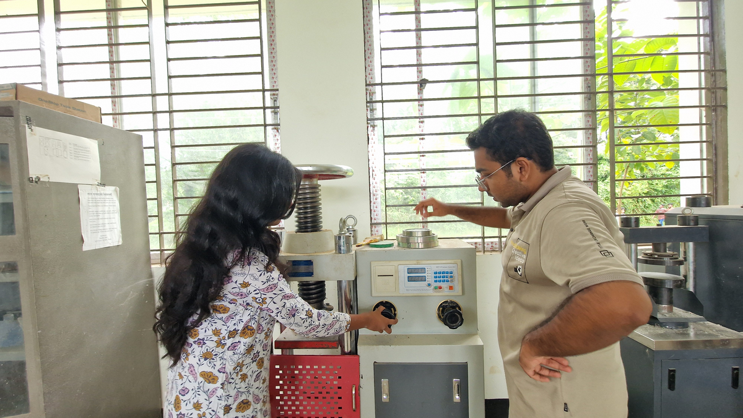
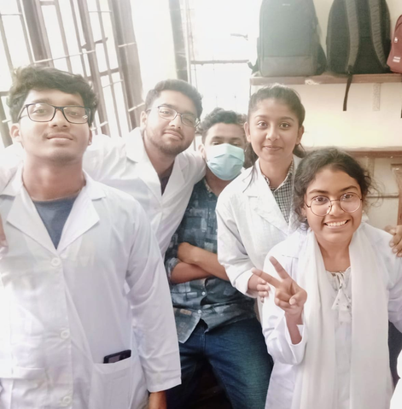
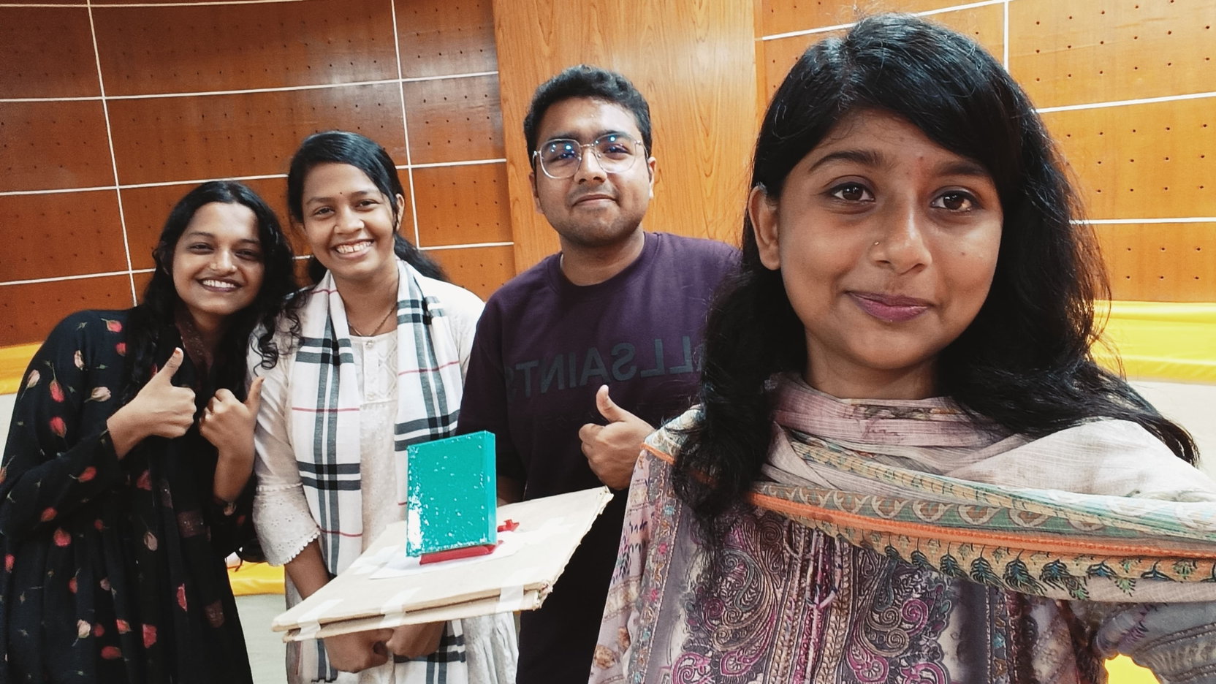
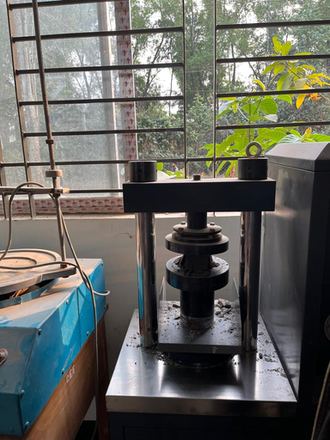
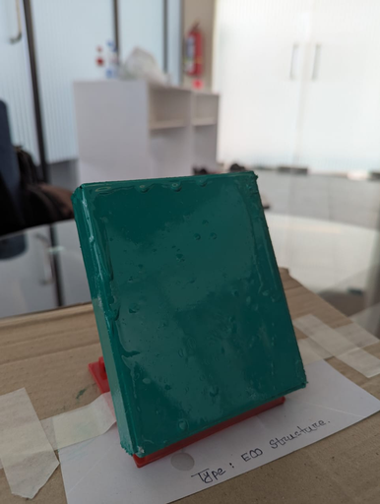
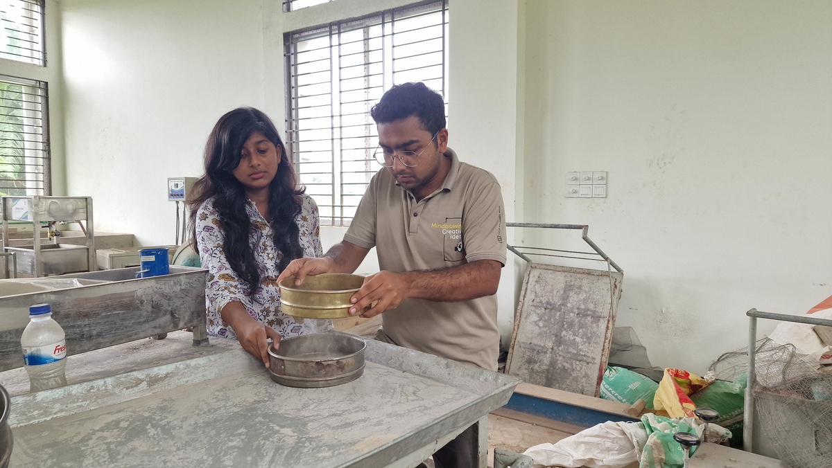
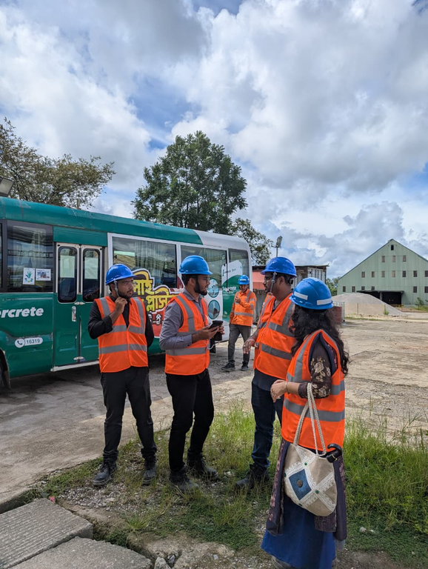
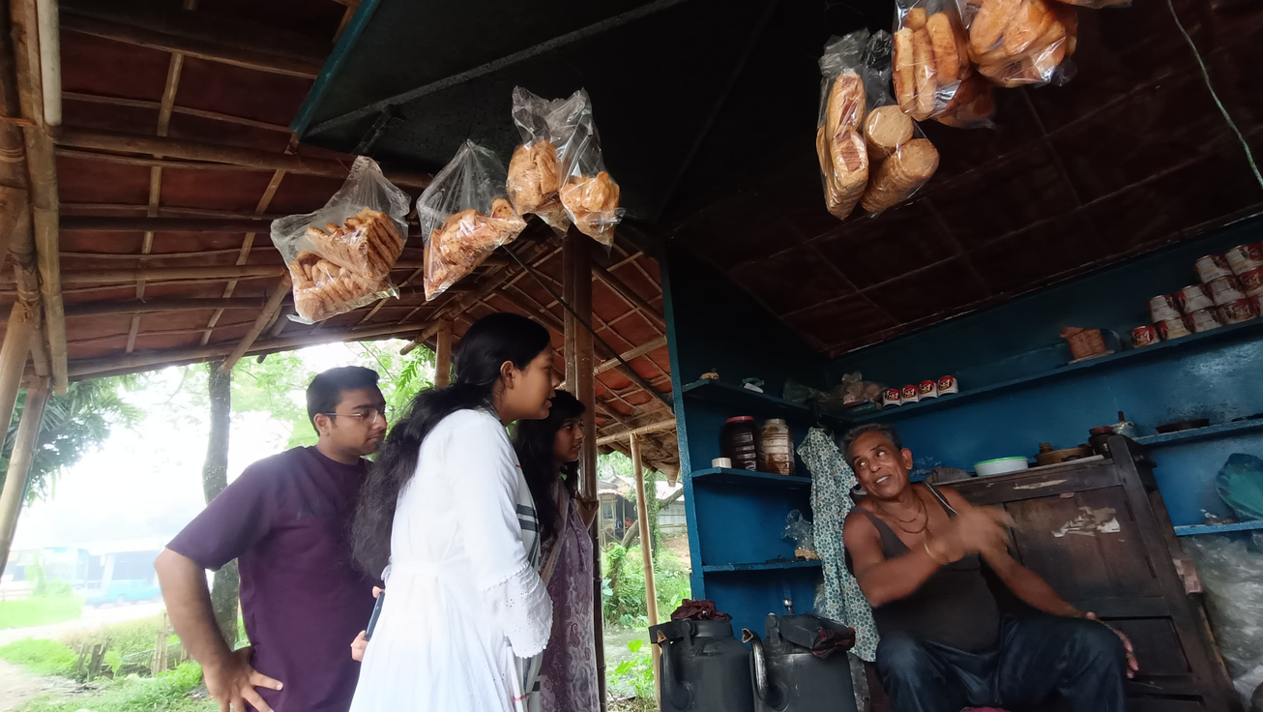
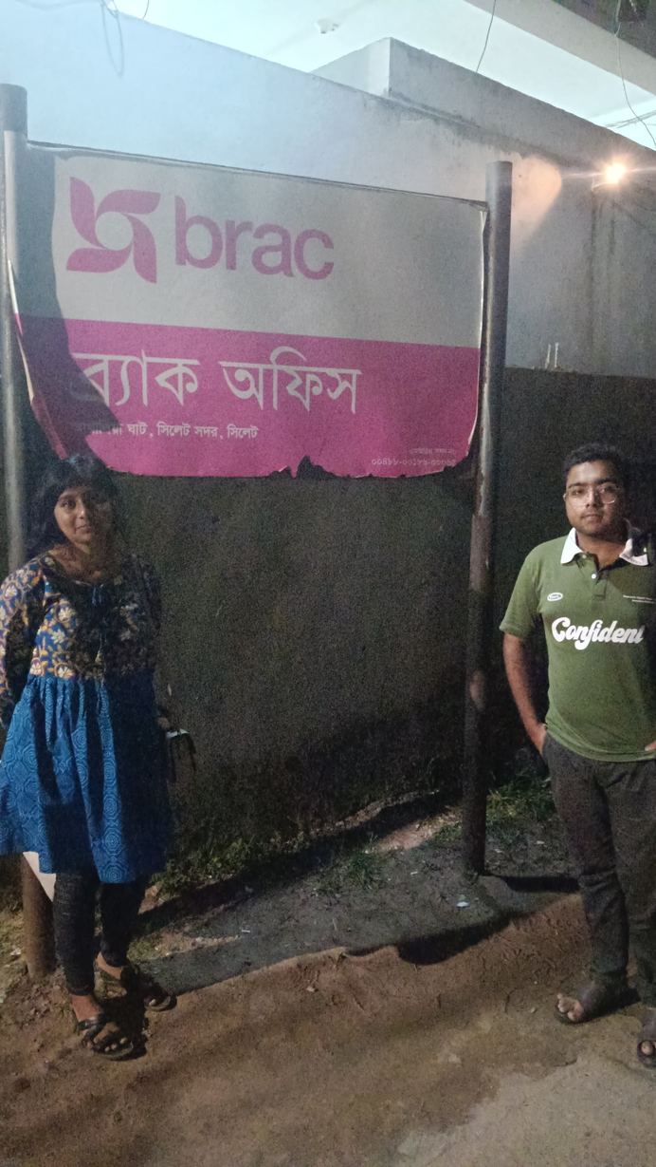
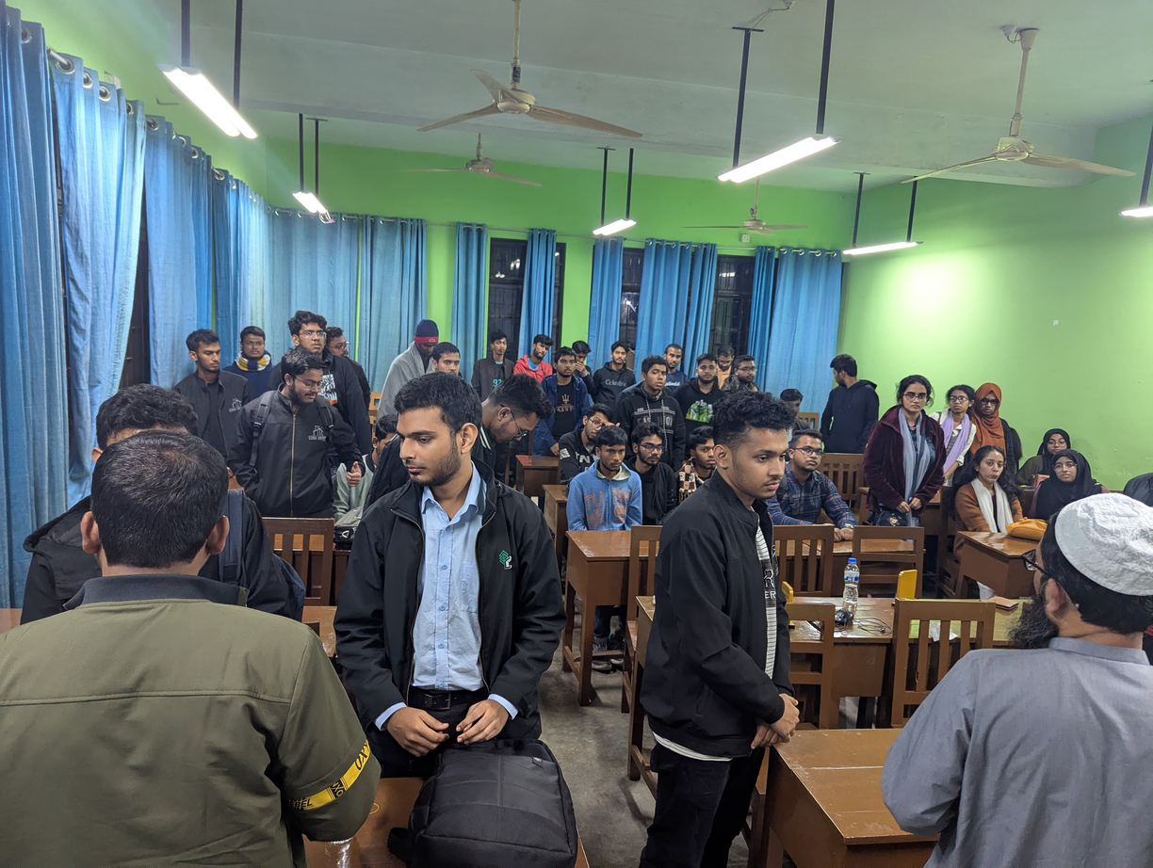
R&D AND PILOT
PRODUCT DEVELOPMENT
TESTING
PROTOTYPE
SURVEY & SESSIONS

Slide 21
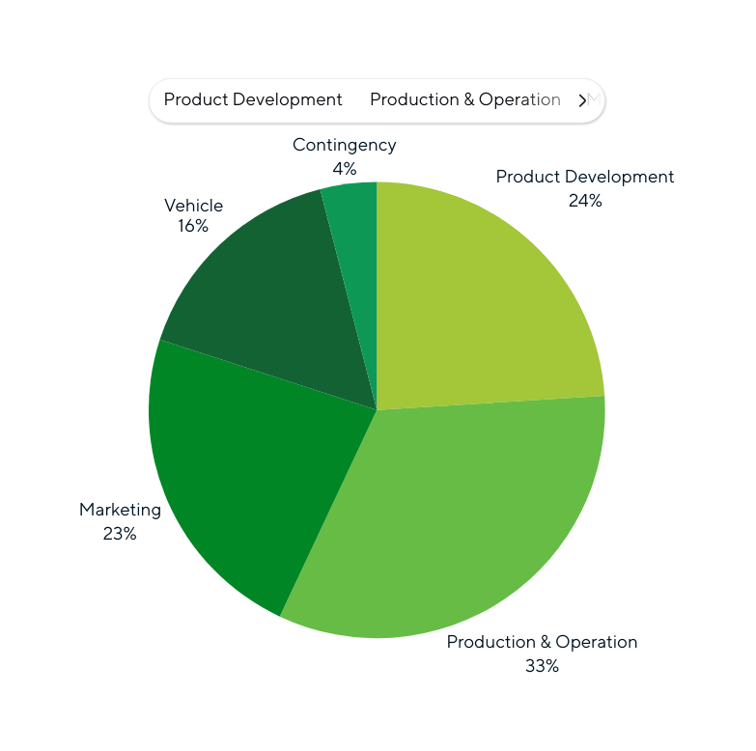
OUR EXPECTATIONS
Product
Development
3600000
24%
Continhency
600000
4%
33%
Production & Operation
4950000
23%
Marketing
3450000
16%
Vehicle
2400000
Total BDT 1.5 Crore

Slide 22
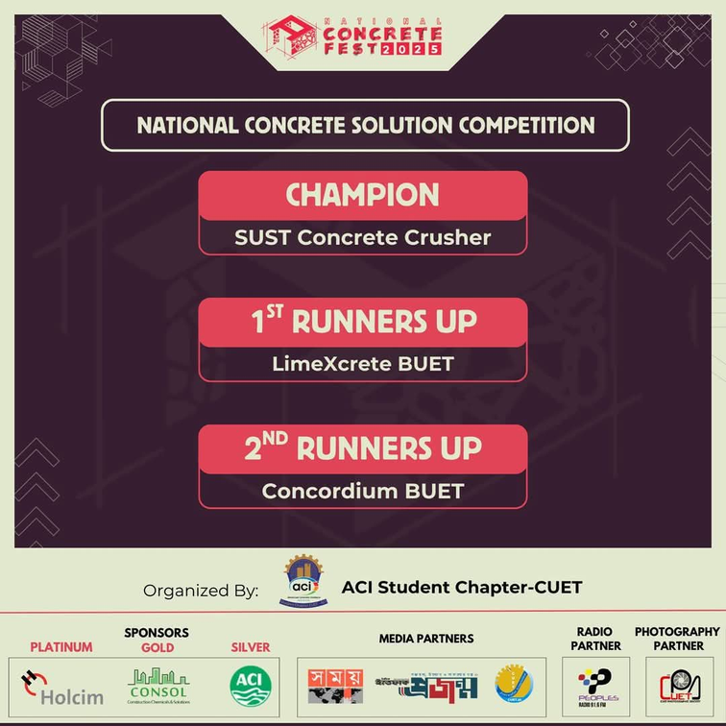
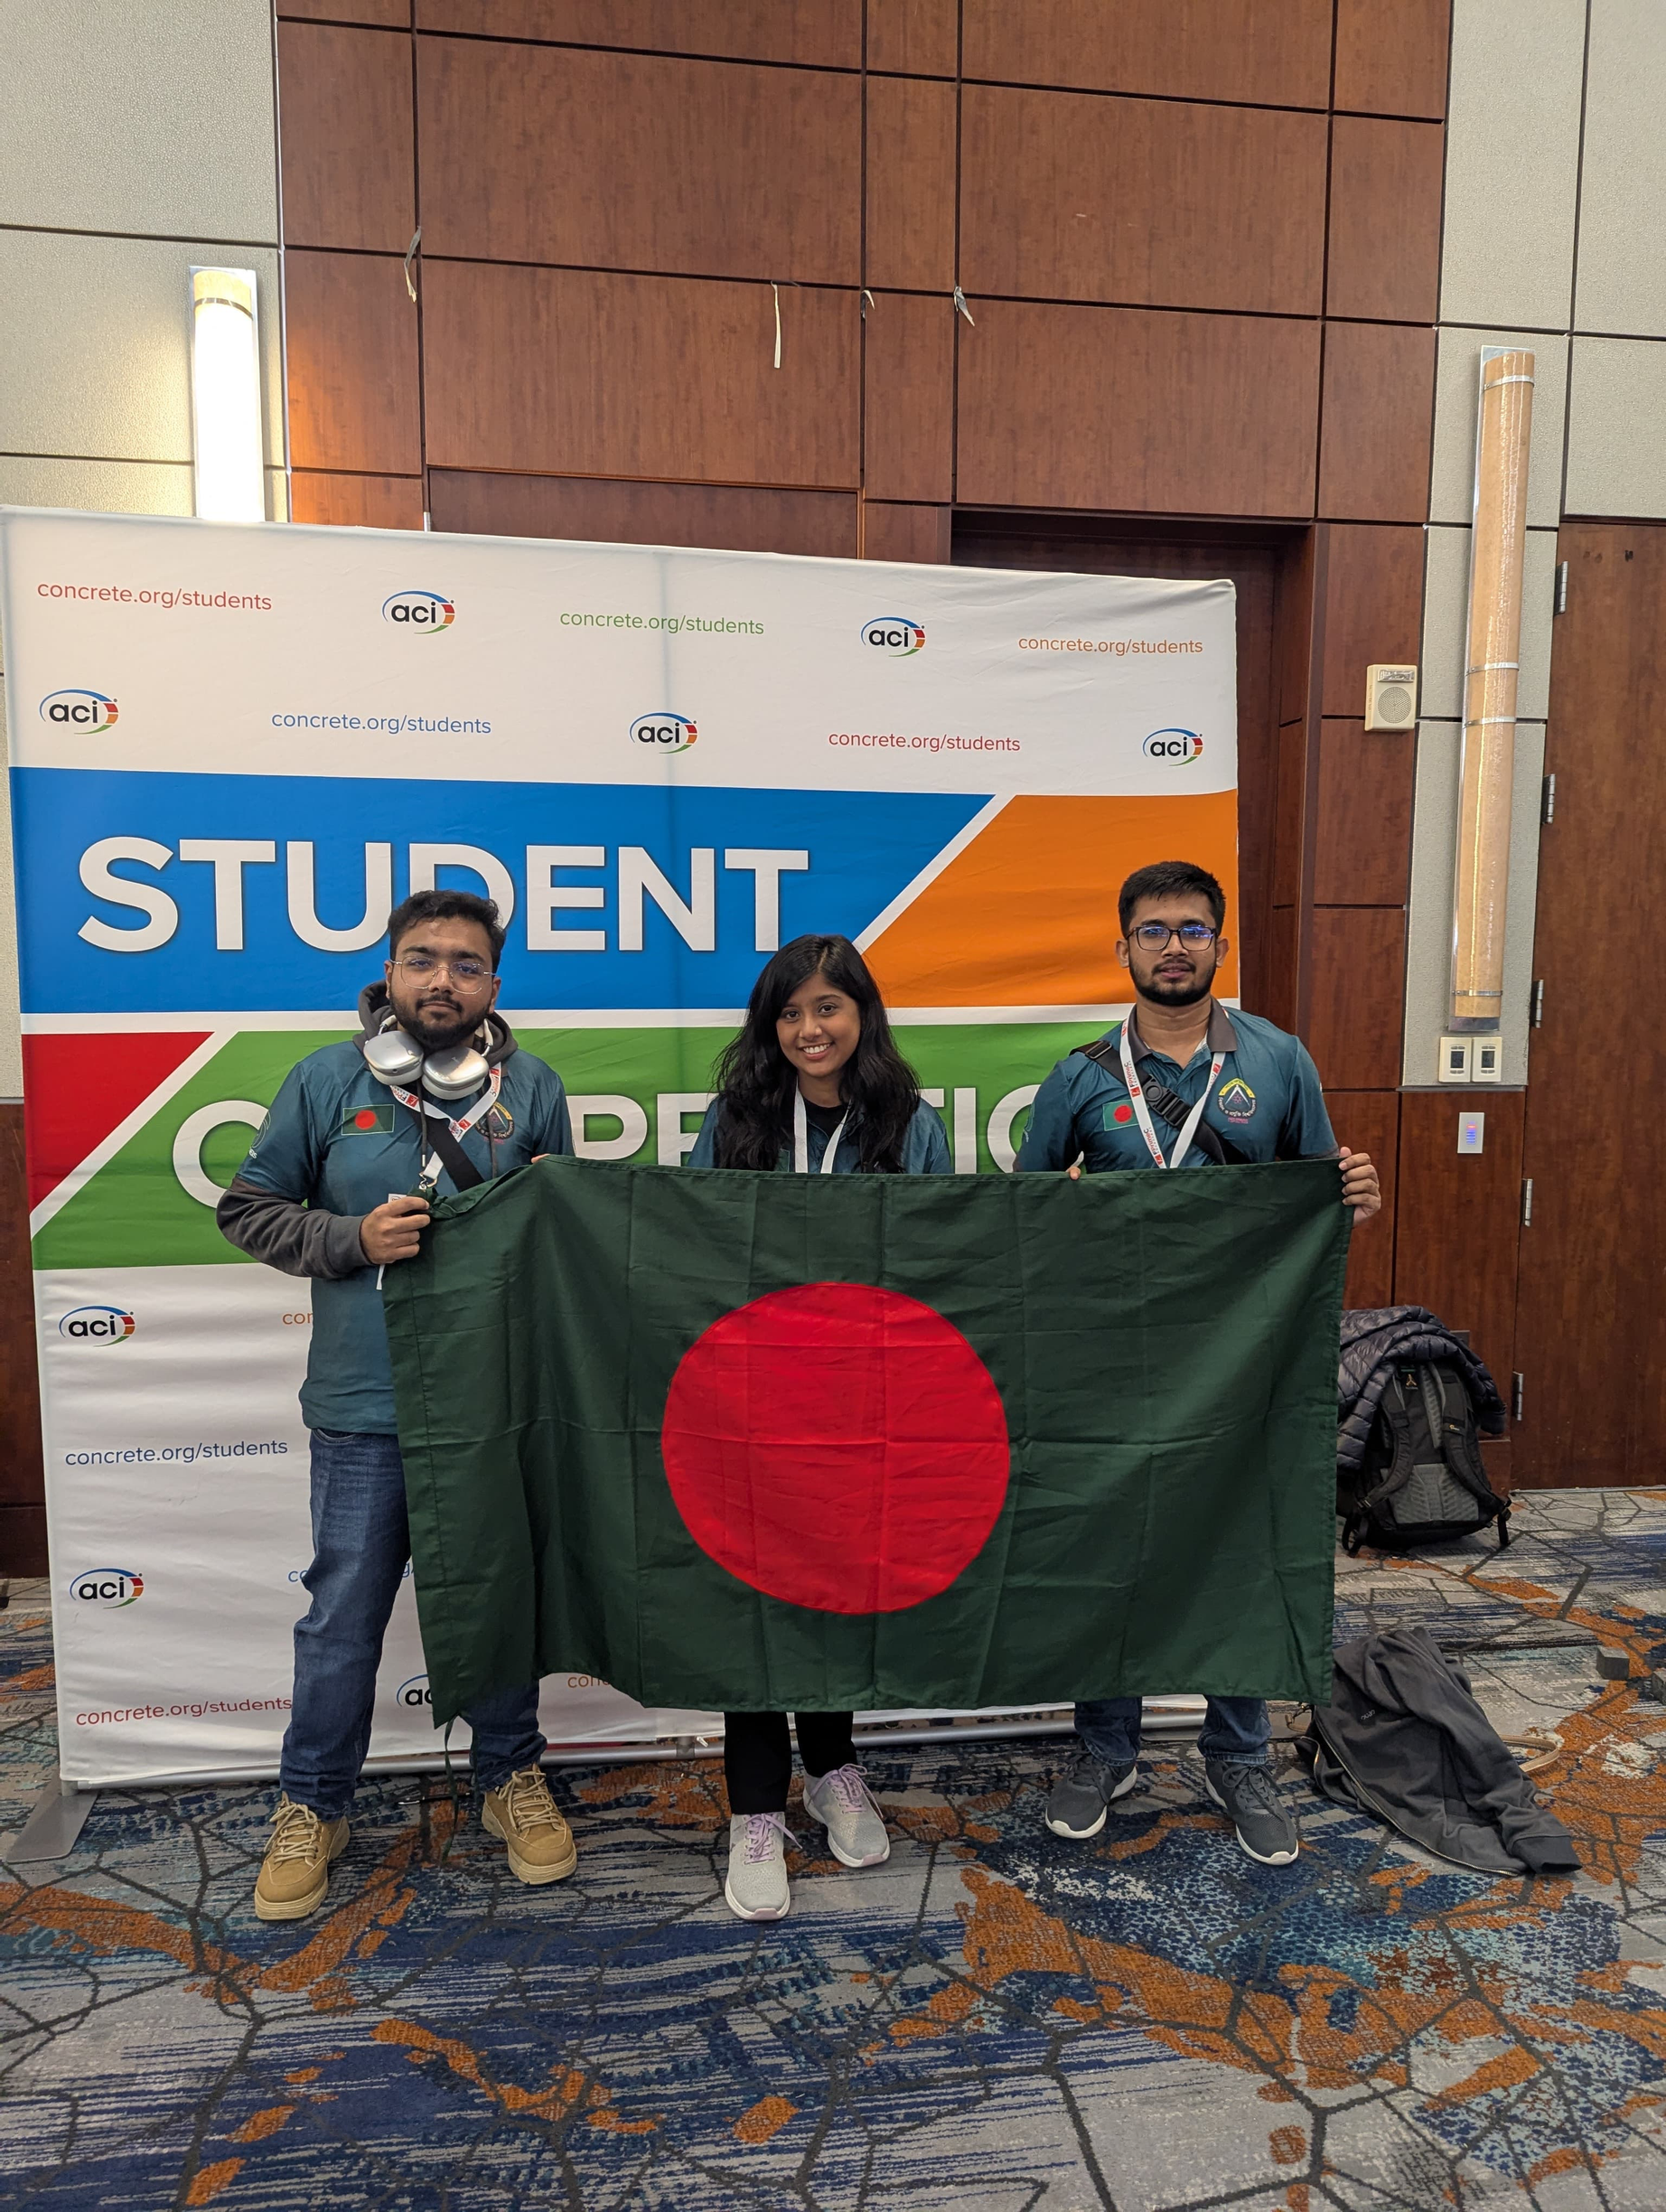
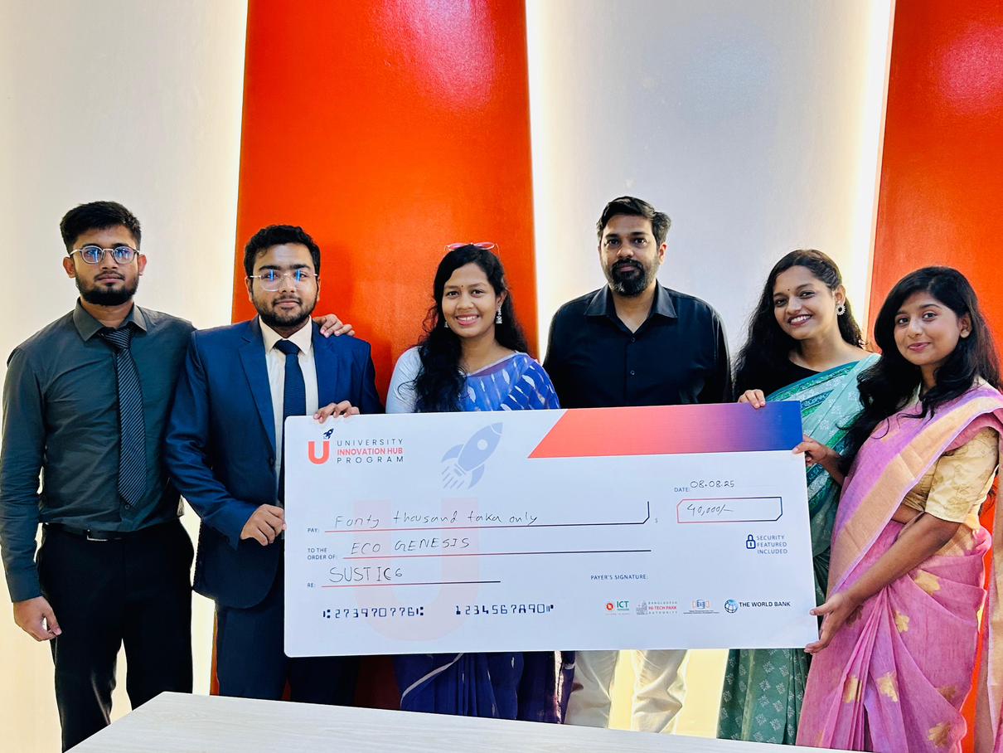
Our Acheivements
Champion in National Concrete Solution Competition By ACI CUET
our world ranking 17th at
American Concrete Institution ,
Baltimore ,USA
Got 2nd HIghest funding in UIHP

Slide 23
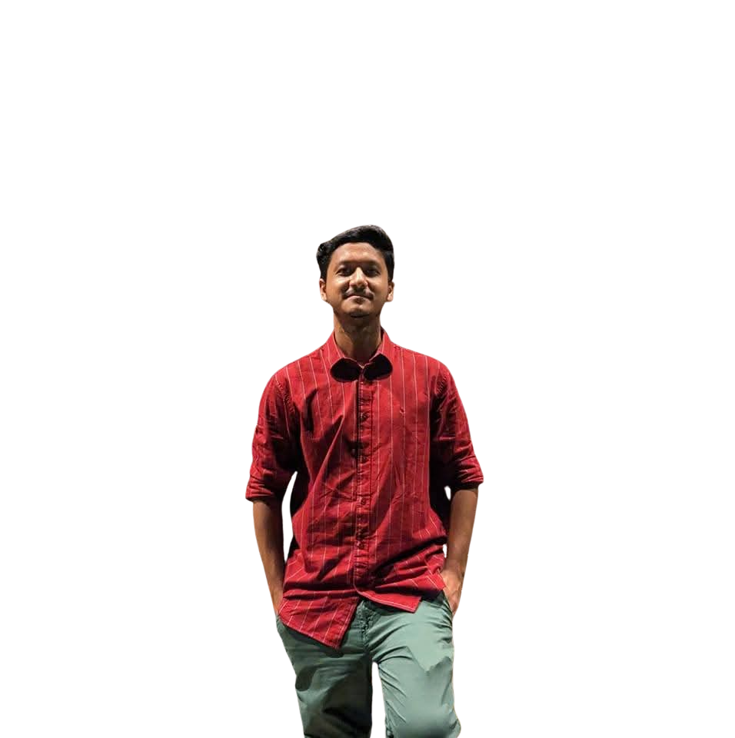
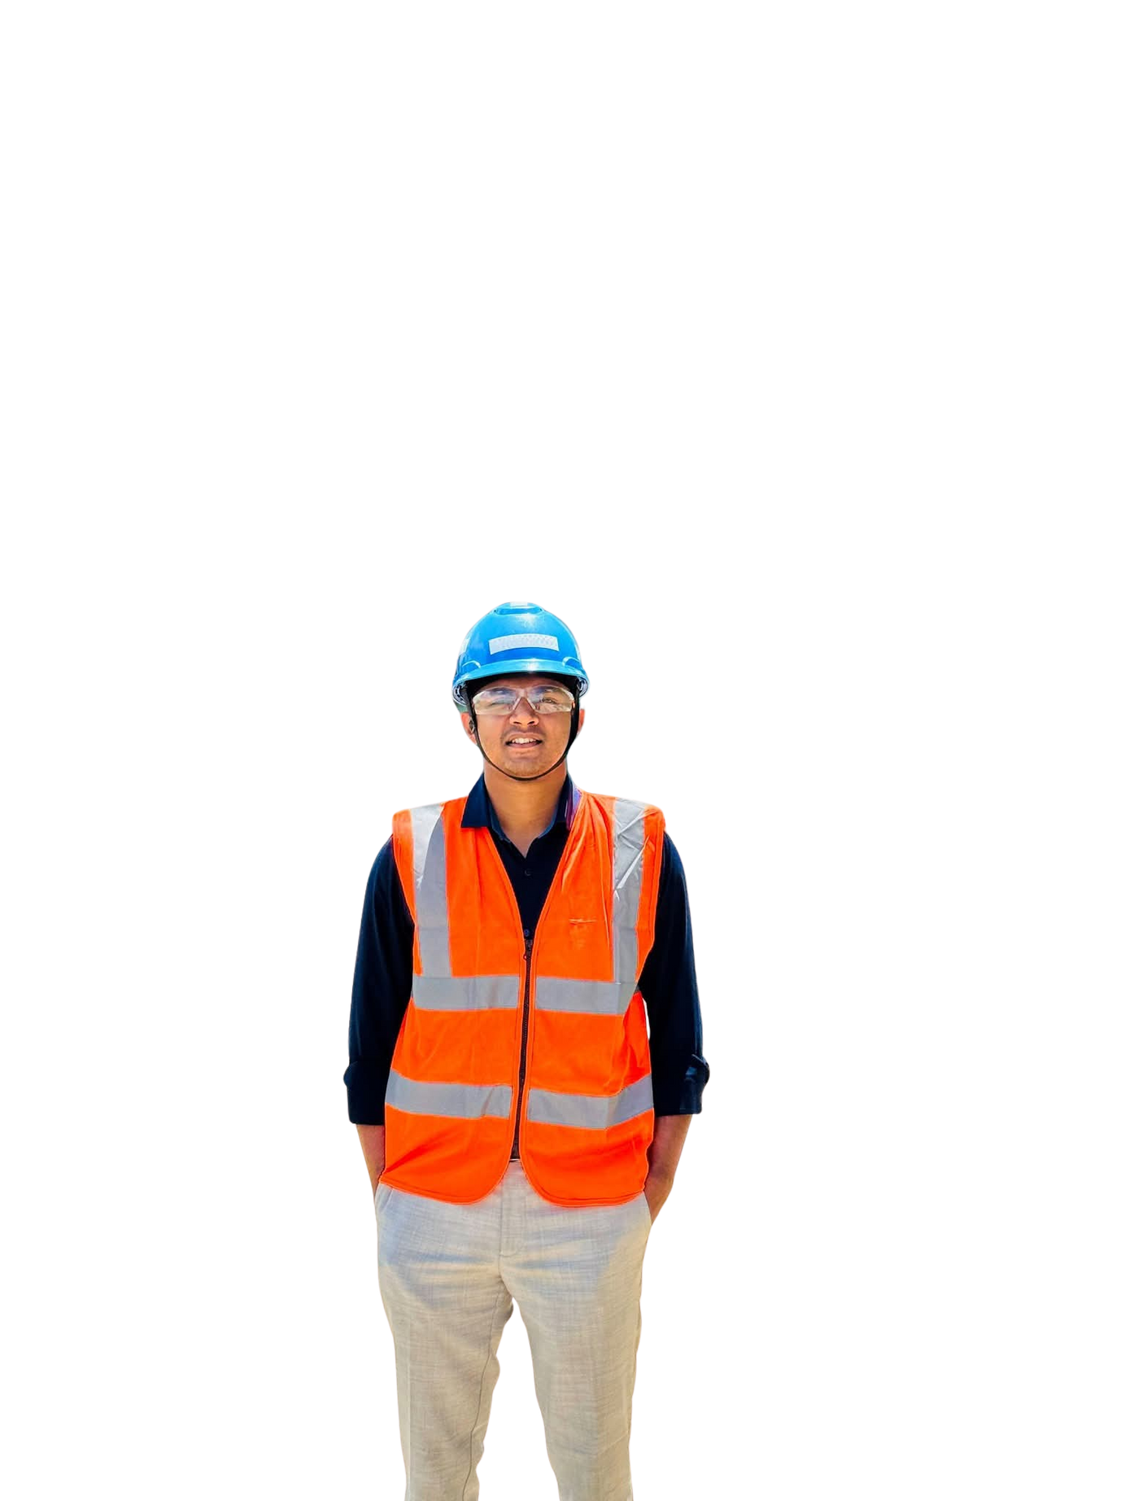
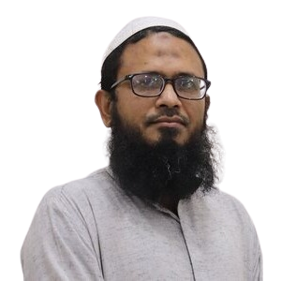
OUR ADVISORS
Heading
Body
ABDULLAH AL NOMAN
Dr. Mohammad Shahidur Rahman
NAHFUZUN NOBI MAHIM
LECTURER
Dept. Of CEE, SUST
Professor & Head
Dept. Of CEE, SUST
TEAM LEAD TECHNICAL SUPPORT ENGINEER
LAFARGEHOLCIM BANGLADESH PLC.

Slide 24
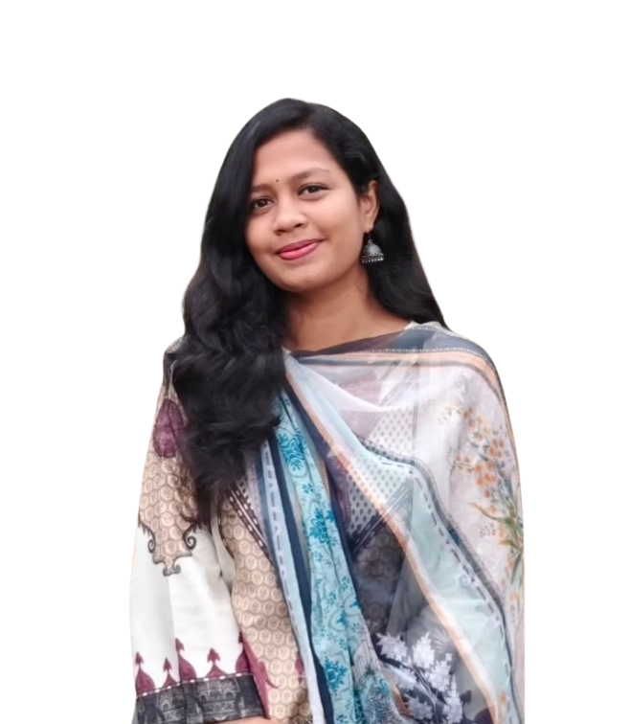
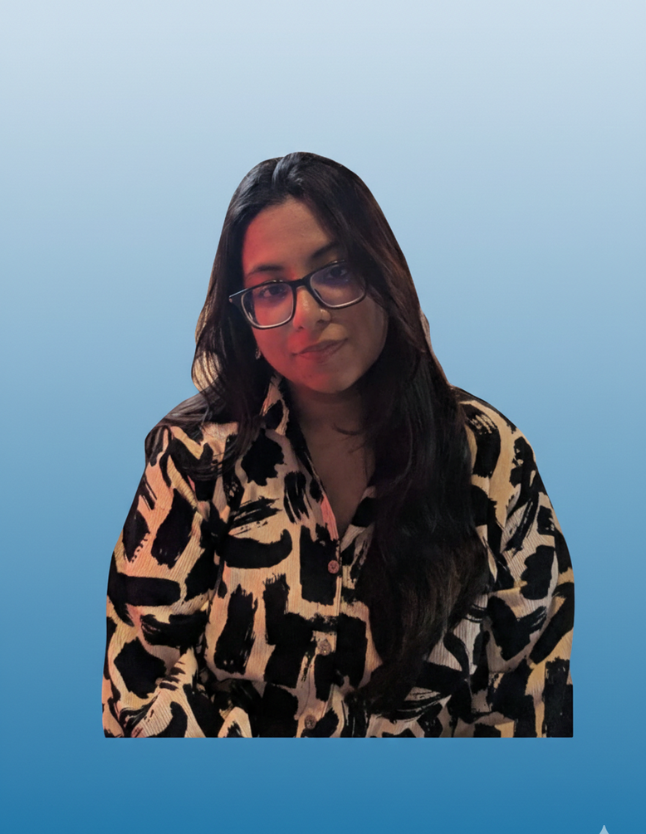
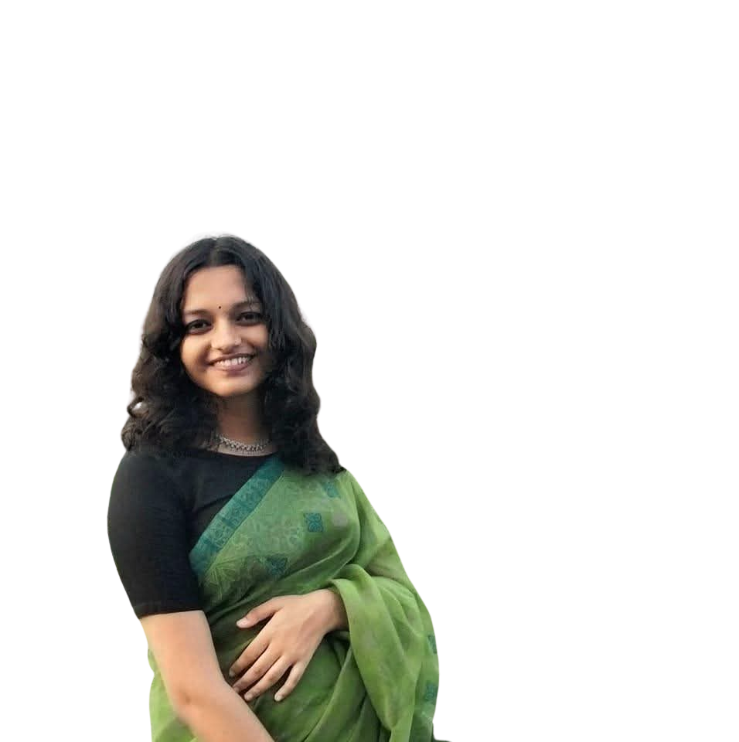
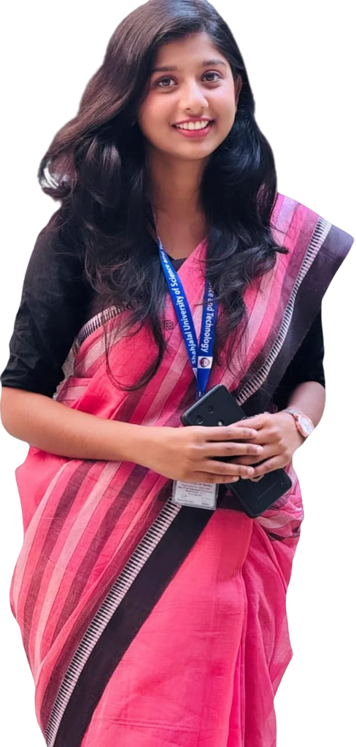
THE PERFECT BLEND OF INNOVATION & WISDOM
Heading
SUBHEADING
Body
TASMIA TAHIRA
FARHANA ISLAM
PRIYA RANI VOKTO
FADEELAH MAHMOOD
Dept. Of STAT, SUST
Dept. Of CEE, SUST
Dept. Of CSE, SUST
Dept. Of CEE, SUST
CHIEF OPERATING OFFICER
CHIEF FINANCE OFFICER
CHIEF TECHNICAL OFFICER
CHIEF MARKETING OFFICER

Slide 25
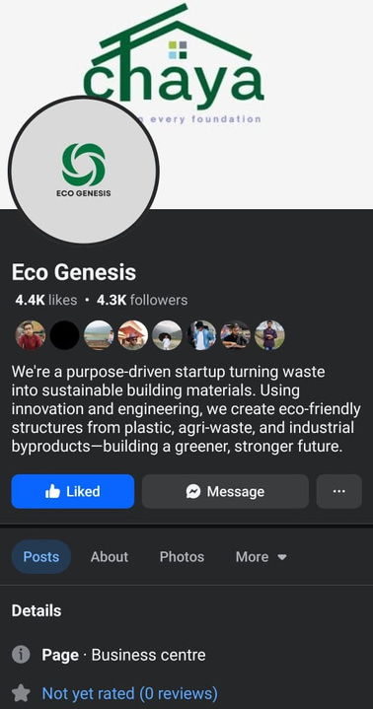
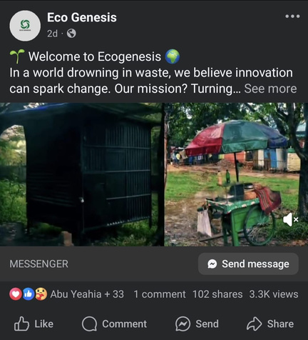
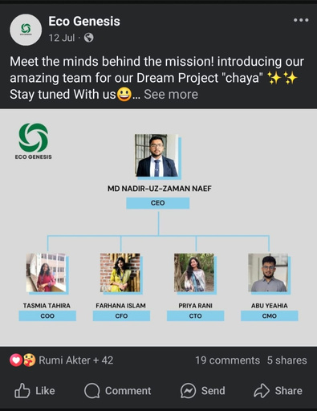
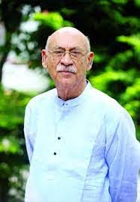
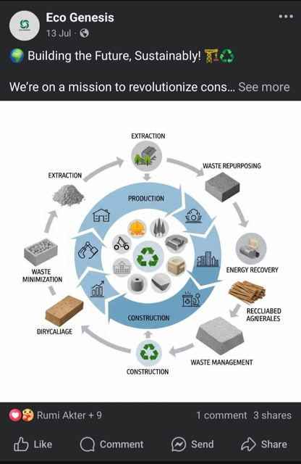
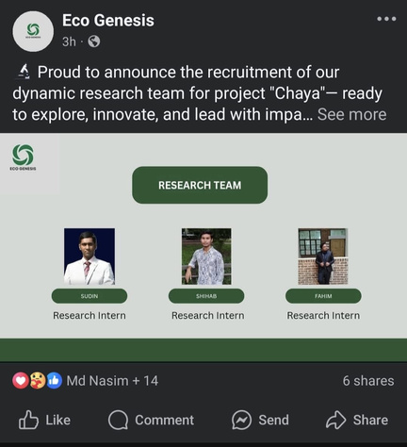




Social Media Engagement
FACEBOOK
Brand Ambassador
FOLLOWERS COUNT : 4.4K
01718555023
https://www.ecogenesis.com
ecogenesis21@gmail.com
Abul Hayat
Bangladeshi Actor
Thank You

